Slide 1
Motion Planning for Multiple Autonomous Vehicles
Logic Based Planning
Presentation of paper: R. Kala, K. Warwick (2013) Motion Planning of Autonomous Vehicles in a Non-Autonomous Vehicle Environment without Speed Lanes, Engineering Applications of Artificial Intelligence, 26(5-6): 1588–1601.
Rahul Kala

Slide 2
Why Logic Based Planning?
Direct interpretation of observed driving behaviours
Issues
Modelling of the individual behaviours
Concept
Balance between being deliberative and being reactive

Slide 3
Key Contributions
Vehicle behaviours in unorganized traffic are studied and identified.
Each behaviour is modelled in an algorithm used for the motion of autonomous vehicles in unorganized traffic.
In particular the complex behaviour of single lane overtaking is studied wherein a driver slips into the wrong lane to complete the overtake. The cases of initiation, cancelation and successful completion of the behaviour are studied.
Driver aggression is studied and modelled as an algorithmic parameter in such traffic.

Slide 4
Problem Modelling
Straight Road: Road with not suddenly narrow thus making an initiated overtake infeasible
Infinitely Long Road: A vehicle may take long to move aside to enable an overtake, the road would not end while this happens, resulting in no overtake.
Vehicles projected to move straight with same speeds

Slide 5
Problem Modelling
Single or dual carriage way?
In general, algorithm valid for any dual carriageway
Only behaviour possible with the two traffics mixing is a single lane overtake (vehicle slips in wrong side to complete an overtake)
Further discussions assume for all behaviours except single lane overtake: road is single way or a virtual boundary divides the two sides
For single lane overtake behaviour: road is dual way

Slide 6
Aggression Factor
Aggression leads to better travel for the aggressive driver at the cost of the other drivers and risk
Modelled as minimum separation that must be kept with a vehicle/obstacle at side
The maximum separation also under threshold
Aggressive overtakes are closer to the vehicle’s occupancy

Slide 7
Design methodology
Observe general driving behaviours
For each behaviour note down when (pre-condition) the behaviour is displayed
Prioritize the behaviours (check for behaviour coexistence)
Note down how the vehicle moves in such a behaviour
Generalize the behaviour for similar situation
Only one behaviour may be displayed any time
Behaviour with the highest priority with valid pre-condition called
E.g. one cannot overtake and overcome an obstacle at the same time

Slide 8
Working Methodology
Select the behaviour whose pre-condition is true
Ties are broken by priorities
Construct trajectory/ motion of the vehicle with such a behaviour
While the vehicle is moving under the selected behaviour, follow in-behaviour specifications
Move till behaviour ends/ is terminated
Assess the scenario

Slide 9
Behaviour Set
Obstacle Avoidance
Complete single lane overtake
Centring
Lane Change
Overtake
Single lane overtake
Cancel single lane overtake
Be overtaken
Maintain Separation Steer
Slow Down
Discover Conflicting Interests
Travel Straight

Slide 10
Behaviour 1: Obstacle Avoidance
Select the best Obstacle Avoidance Point
Join current position to avoidance point by a trajectory
The trajectory is checked for feasibility
Traverse a sweeping line along the length of the road
For every obstacle-free segment of line, find best avoidance point
Find overall best avoidance point

Slide 11
Behaviour 1: Obstacle Avoidance
Located on widest obstacle-free segment
Maximize separation
Minimum deviation from vehicle’s lateral position on the road (minimum steering)
Traverse a sweeping line along the length of the road
For every obstacle-free segment of line, find best avoidance point
Find overall best avoidance point
Rightmost or leftmost among all the candidate points (no steering should be required for subsequent part of obstacle)
Leads to a collision-free trajectory
Look at nearer obstacles if furtherer ones lead to collision

Slide 12
Behaviour 1: Obstacle Avoidance
Sweeping Line
Obstacle
Wider side
Current Position (L)
A
D
B
C
Best avoidance points are A, B, C and D based on widest segment and widest separation
Overall best is B
If A is select the vehicle will need 2 turns: L to A, A to B
If B is select the vehicle will need 1 turn: L to B
Vehicle cannot construct a collision free trajectory from L to C or D

Slide 13
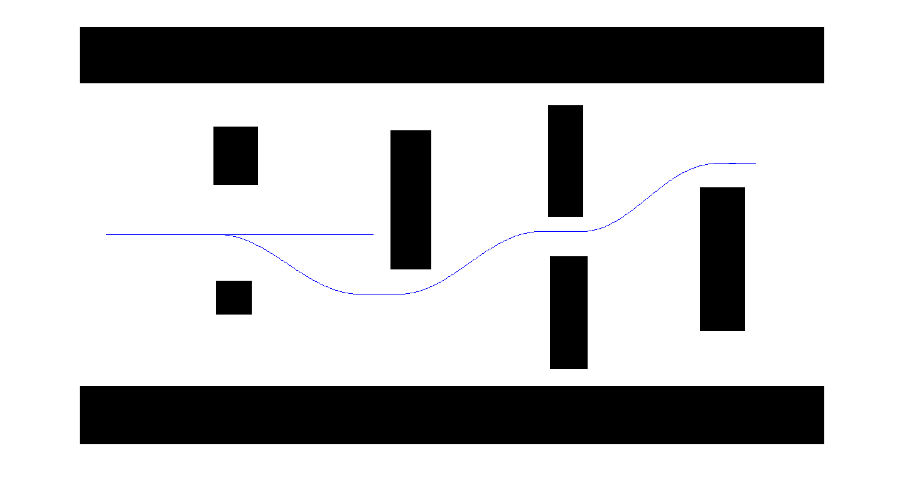
Behaviour 1: Obstacle Avoidance
Each point of obstacle avoidance is as per the objectives of keeping relative position same and maximizing separation (under threshold)

Slide 14
Behaviour 2: Centring
If no other vehicle/ obstacle as per projections
Slowly drift towards the centre of the road

Slide 15
Behaviour 3: Lane Change
Not a behaviour – A condition which must be true on any lateral movement
Lane change trajectory
Very fast
Very slow
Lane change only allowed if the complete trajectory can be traversed without other (blue) vehicle slowing.
Else purple vehicle may come ahead of the blue vehicle, not giving it enough time to slow down

Slide 16
Behaviour 4: Overtaking
Decide the vehicle to overtake
Decide the point of overtake
Construct overtaking trajectory
Do other vehicles need to move?
Decide the side to overtake
Overtaking
Direct Overtaking
Assistive Overtaking
Sufficient separation available – movement of other vehicles not mandatory
Sufficient separation not available – movement of other vehicles mandatory
Jump to slide 25 to avoid details

Slide 17
Behaviour 4: Overtaking
Decide the vehicle to be overtaken (only one)
Faster vehicle within the overtaking
Least lateral deviation from the overtaking vehicle
Not too far ahead
Larger lateral deviation
Overtaking vehicle
Vehicle to be overtaken
Too far ahead to be overtaken
Faster vehicles ahead, laterally within this distance considered for overtaking

Slide 18
Behaviour 4: Direct Overtaking
Direct Overtake - either/both sides of overtaking has minimum separation available
Side of overtake – If vehicle to be overtaken more towards left, overtake from right, and vice versa
Point of overtake – Laterally attempt to maintain maximum separation (under threshold) and minimum deviation from the current lateral position
Point of overtake is taken distant enough along the length of the road so as to allow the vehicle easily correct its lateral position

Slide 19
Behaviour 4: Direct Overtaking
Vehicle being overtaken more towards right, so overtake from the left
Point of overtaking (maximizes separation)
Overtaking vehicle
Vehicle to be overtaken
Distance decided based on amount of change in lateral position
Separation needed for overtaking

Slide 20
Behaviour 4: Assistive Overtaking
Assistive Overtaking – Neither side has available separation at the start
Assuming all the other vehicles ahead move aside, compute total separation available
If that separation can host the overtake, select side and point as per the rules of direct overtaking
Keep moving and waiting for the other vehicles to move aside

Slide 21
Behaviour 4: Assistive Overtaking
Enough separation to host overtake (basic safety distance per vehicle subtracted)
Overtaking vehicle
Vehicle to be overtaken

Slide 22
Behaviour 4: Assistive Overtaking
Both vehicles simultaneously attempt overtake, more aggressive may succeed

Slide 23
Behaviour 4: Assistive Overtaking
Expected turns of the other vehicle in future (by other behaviours)
Overtaking vehicle

Slide 24
Behaviour 4: Assistive Overtaking
If feasible, generate overtaking trajectory
Wait for other vehicles to move and generate space (other vehicles constantly pushed to allow overtake)
Assess feasibility of assistive overtake
Travel the trajectory with highest speed avoiding collision with any vehicle in the front

Slide 25
Behaviour 5: Be Overtaken
Cooperation by a vehicle to allow overtake of another vehicle. May make an infeasible overtake feasible (as in assistive overtake), or make an overtake easier
Select the vehicle attempting overtake to be allowed overtaking of
Guess the side of overtaking and plan to move to the opposite side
Decide the magnitude to move
Construct the be overtaken trajectory
Separation needed for overtake
If unavailable maximum that vehicle can offer
Anything excess is shared (under threshold)
Closest vehicle behind selected

Slide 26
Behaviour 5: Be Overtaken
Region within which overtaking vehicle is searched for
Overtaking vehicle
Be overtaken trajectory (allows for overtake with maximum separation)
Vehicle to be overtaken

Slide 27
Behaviour 6:Maintain Separation Steer
Too less separation from right and too much on left, turn right to increase separation (under threshold)
Projected maximum separation
Choice of Regularization Point: Increase separation as much as possible (under threshold) on both sides
Regularization Point

Slide 28
Behaviour 7:Slow Down
Too less separation on both sides, cannot be increased by steering – SLOW DOWN
Out of all vehicles, least aggressive would slow down first, whose backing up may increase separation for the others

Slide 29
Behaviour 8: Discover Conflicting Interests
R_{i}
Points of straightening
Current Separation
Straightened trajectories
R_{j}
Original trajectories
At the time of planning both vehicles assumed each other to travel straight
All behaviours checked other vehicles not turning towards it, making planned separations smaller
Conflicting plans sensed by projective drop in separations below threshold
Trajectories straightened and followed – Behaviour being exhibited cancelled

Slide 30
Behaviour 9: Travel Straight
Take a unit move along the road
No pre-requisites

Slide 31
Single Lane Overtake
Check feasibility
Initiate
Continue
Check feasibility
Complete
Cancel

Slide 32
Behaviour 10: Single Lane Overtake Initiation
Enough separation to host overtake

Slide 33
Behaviour 10: Single Lane Overtake Initiation
Overtaking vehicle
Vehicle being overtaken
Overtake initiation trajectory
Point of overtake, based on maximum separation (under threshold)

Slide 34
Behaviour 10: Single Lane Overtake Initiation
Overtaking vehicle
Vehicle being overtaken
Overtake completion trajectory
Overtake initiation trajectory
Phase where overtaking happens
All vehicles assumed to travel straight with the same speed
If the trajectory can be traced with no collision, overtake is initiated

Slide 35
General travel with single lane overtake
Overtaking vehicle
Vehicle being overtaken
Once vehicle is in the wrong lane, it continues to travel as per other behaviours with overtaking behaviour disabled

Slide 36
General travel with single lane overtake
Maximum speed set so as to avoid any collision with vehicle in front (if any)
Overtaking vehicle
Maximum speed set to avoid collision, accounting for blue vehicle moving with constant speed
Maximum speed set to stop early enough so as to give red vehicle enough distance to forcefully go back in the correct lane, not considering any other vehicle

Slide 37
Behaviour 11: Cancelling single lane overtake
Compute earliest point of return which may be used by overtaking vehicle to forcefully return.
Construct returning trajectory.
Compute distance required in the wrong lane by the returning trajectory.
If distance with any oncoming vehicle projected to be smaller than required, cancel overtake.
Compute actual point of return and actual return trajectory
Vehicle travels using returning trajectory, at every step maximum speed to disallow collision with any vehicle in front.

Slide 38
Behaviour 11: Cancelling single lane overtake
Earliest point of return
Distance required in the wrong side
Considering speeds and accelerations, if distance likely to fall under marked, retreat would happen

Slide 39
Behaviour 12: Completing single lane overtake
Once overtaking vehicle is ahead of the vehicle being overtaken, and
Separation is available to go to correct side
Compute point of return and returning trajectory
If separation not available, continue travelling ahead in the wrong lane

Slide 40
Summary
S. No. | Behaviour | Pre-Condition | Description | In-behaviour specifications | Priority
1. | Obstacle Avoidance | Obstacle discovery, lane change true | Strategy to avoid obstacle | Check for collisions with vehicle in front, obstacle avoidance | 1
2. | Centring | No vehicle, no obstacle, vehicle moving by large speeds | Put vehicle in road’s centre | NIL | 2
3. | Lane Change | Called by other behaviours | Whether possible to steer | NIL | NA
4. | Overtake | Slower vehicle ahead, sufficient separation available assuming cooperation of all vehicles ahead, lane change true, not undergoing single-lane overtake | Strategy to initiate overtake, ask other vehicles to move, and eventually align so that travelling straight completes overtake | Discover Conflicting Interests, Check for collisions with vehicle in front | 3
5. | Single lane overtake | Slower vehicle ahead, sufficient separation available, lane change true, no collisions with vehicle in wrong side for expected time of completion of overtake assuming no cooperation | Attempt to initiate a single lane overtake by placing the vehicle in wrong side | Check for cancel single lane overtake, Check for collisions with vehicle in front | 4
6. | Cancel single lane overtake | Performing single lane overtake, sufficient separation not available or not expected to be available in the future even with the largest deceleration to return to the original lane because of a vehicle ahead in the wrong side | Attempt to place the vehicle in correct side and not allow any subsequent motion in wrong side | Check for collisions with vehicle in front and if clear move ahead | NA

Slide 41
Summary
S. No. | Behaviour | Pre-Condition | Description | In-behaviour specifications | Priority
7. | Complete single lane overtake | Performing single lane overtake, sufficient separation available at the correct side, lane change true | Post overtake return to the correct side | Check for collisions with vehicle in front | 5
8. | Be overtaken | Vehicle at the back shows need of overtaking, separation available to offer, lane change true, not undergoing single-lane overtake | Align so that vehicle at the back needing to overtake has more overtaking separation | Discover Conflicting Interests, Check for collisions with vehicle in front | 6
9. | Maintain Separation Steer | Maximum separation possible not available at both ends while steering in some manner can increase current lowest separation, lane change true | Steer to maintain as high separation as possible (not more than threshold) from both ends | Discover Conflicting Interests, Check for collisions with vehicle in front | 7
10. | Slow Down | No adjustment of steering capable of generating minimal separation at both ends | Reduce speed | NIL | 8
11. | Discover Conflicting Interests | A neighbouring vehicle steering towards vehicle being planned found too close while the vehicle being planned was steering towards it, vehicle following a non-straight trajectory | Straighten trajectory being followed | Check for collisions with vehicle in front | NA
12. | Travel Straight | NIL | Take a unit step forward as per road’s current orientation | Check for collisions with vehicle in front | 9

Slide 42
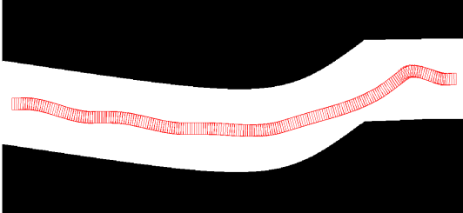
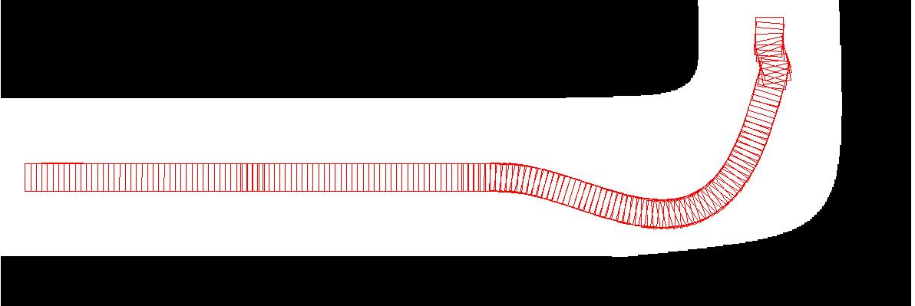
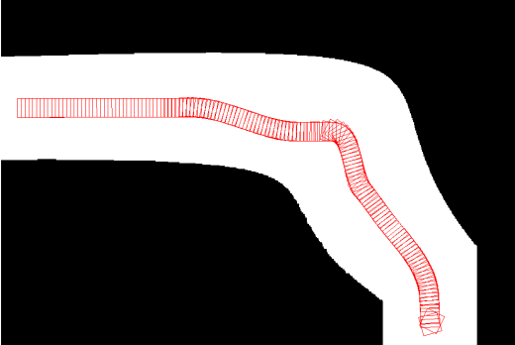
Results

Slide 43
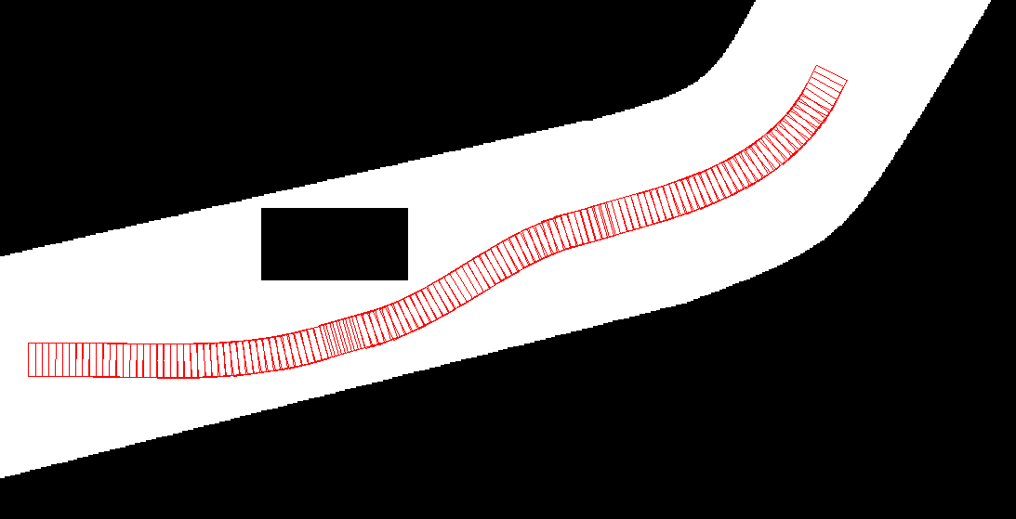
Results

Slide 44
Results

Slide 45
Results
Unequal aggression factors
Equal aggression factors

Slide 46
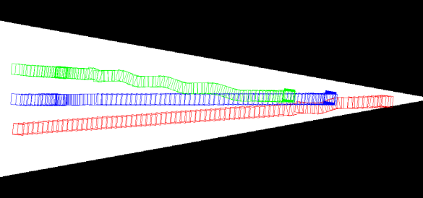
Results – Aggression
Higher aggressive vehicle makes it to the end

Slide 47
Results – Single Lane Overtake

Slide 48
Thank You
Acknowledgements:
Commonwealth Scholarship Commission in the United Kingdom
British Council

